Slide 1
EPA BMDS Version 3.2
ENV H 577
Autumn 2020
Notes:
Thanks Elaine for the introduction!
Hi everyone, and thank you for coming to my general exam, I hope you enjoy the talk today!

Slide 2
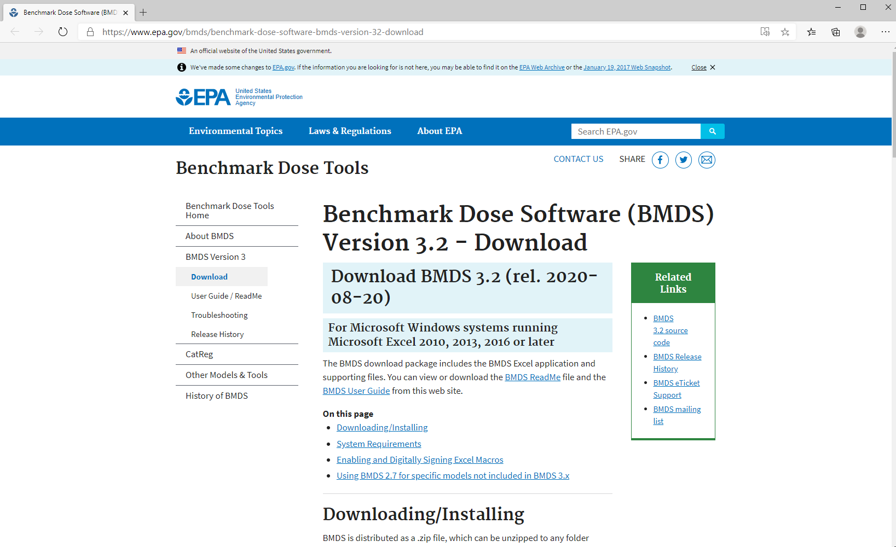

Slide 3
When downloading and installing BMDS
https://www.epa.gov/bmds/benchmark-dose-software-bmds-version-32-download
Keep the file path short: For best results, place the extracted folder (and its subfolders) in the simplest, shortest directory, without special characters or spaces, and for which you have administrative rights (for most users, this will be C:\Users\[user's LAN ID], but sometimes includes C:\).​

Slide 4
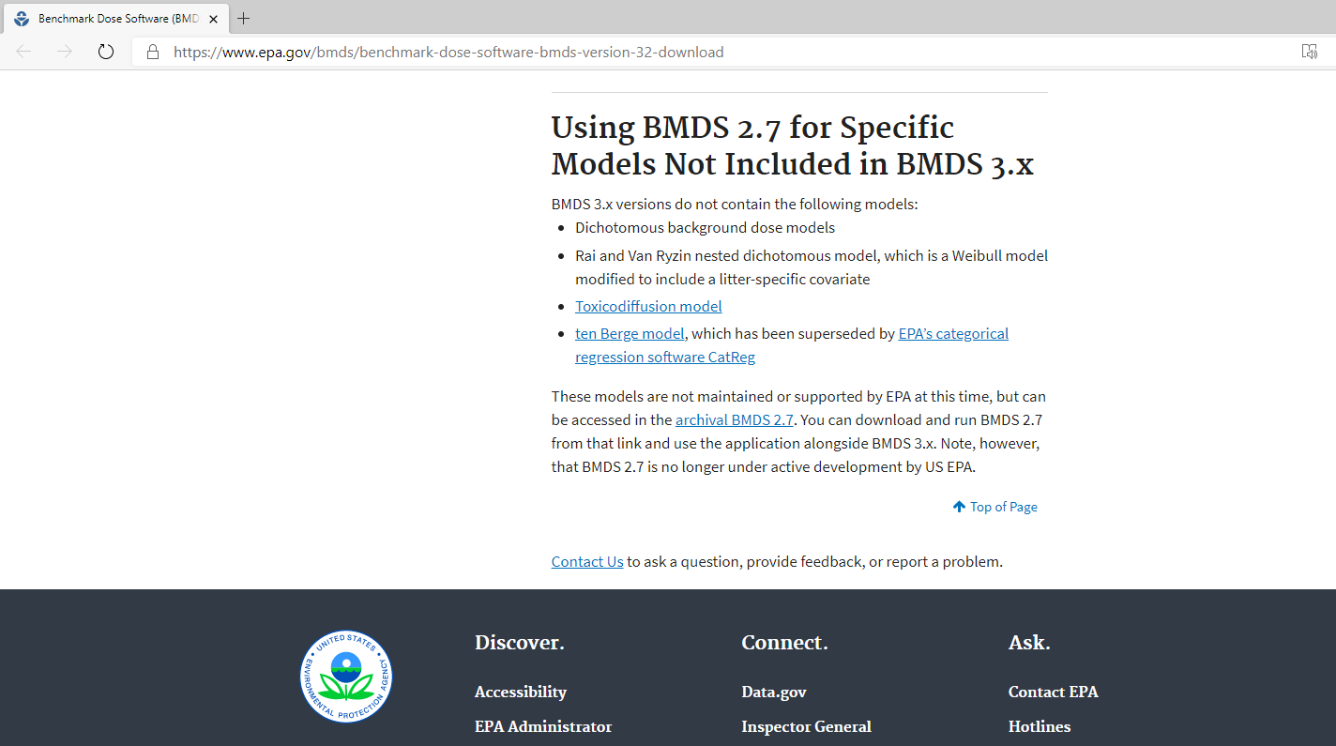

Slide 5
BMDS: Quantal Data
Data includes dose groups, sample size per dose and frequency of incidence
Dose (mg/kg/day) | Animals (n) | Incidence (n)
0 | 75 | 0
5 | 50 | 0
25 | 50 | 9
50 | 50 | 15

Slide 6
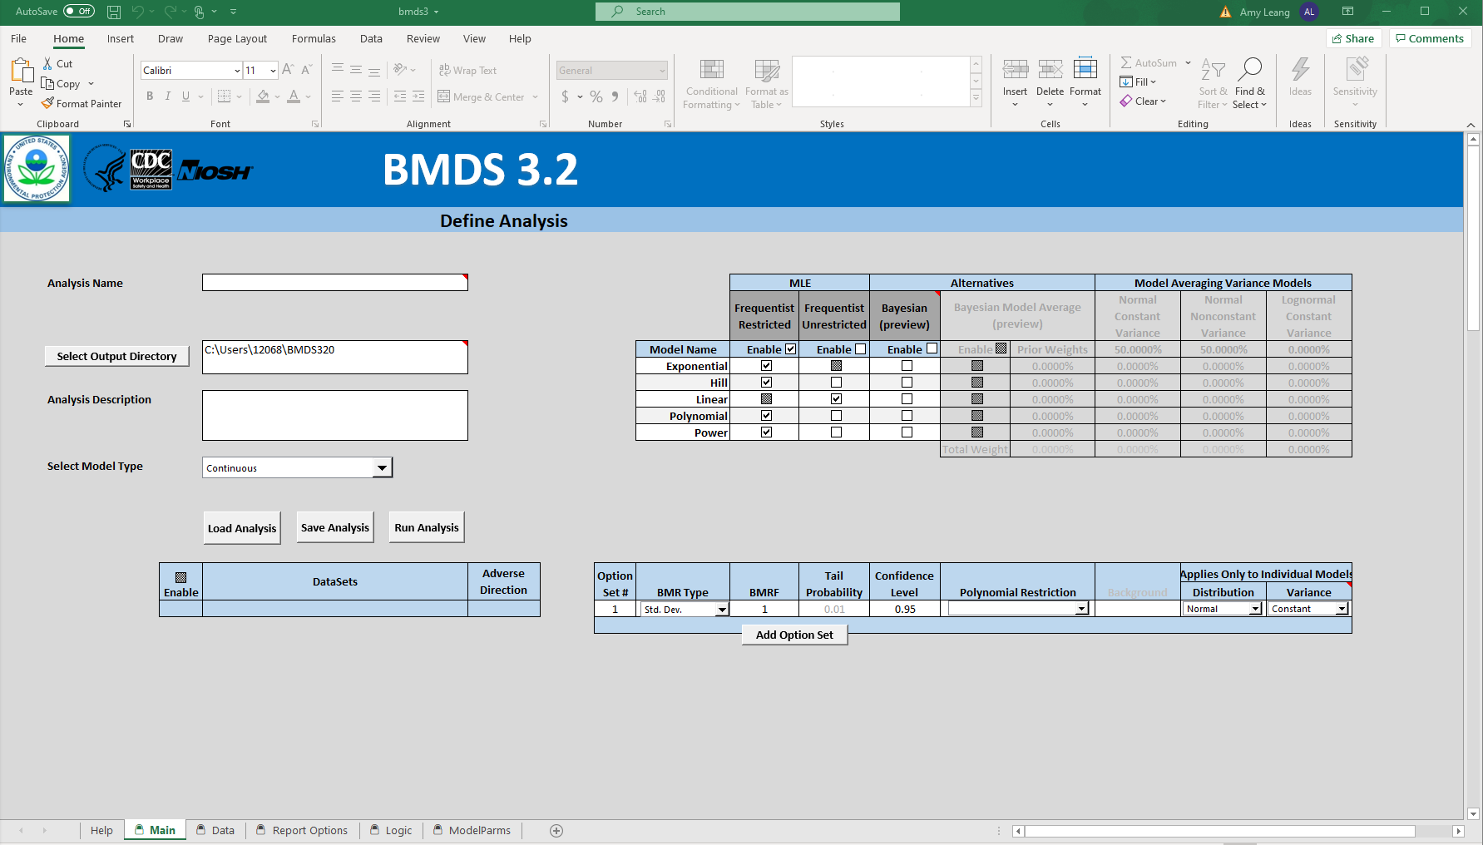

Slide 7
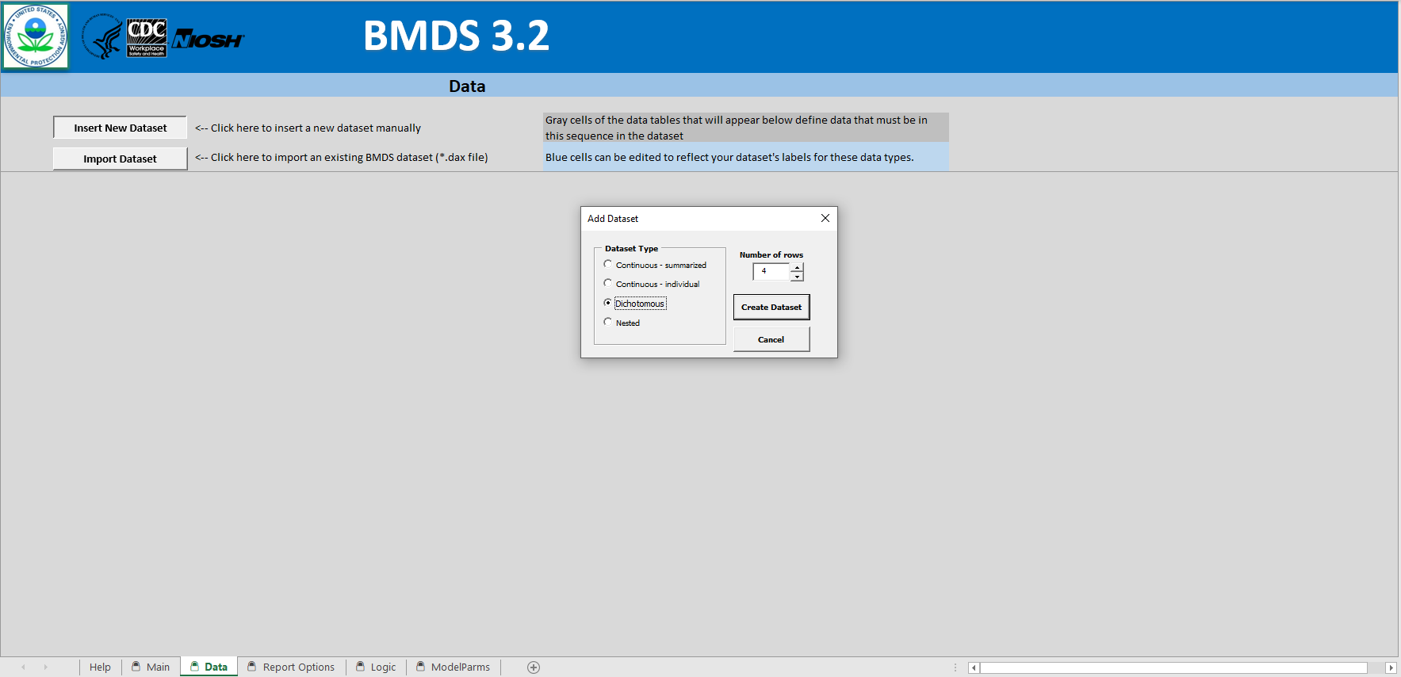

Slide 8
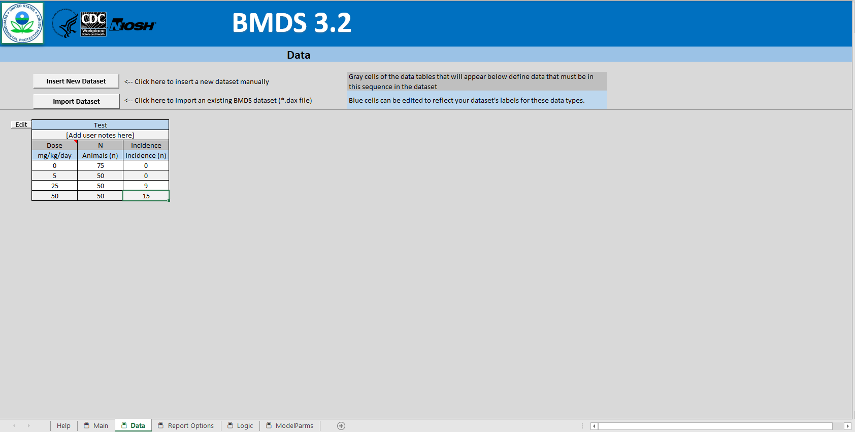

Slide 9
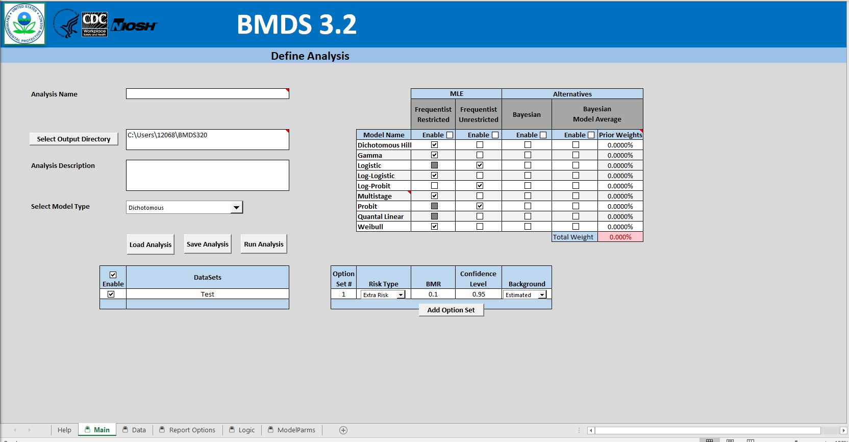

Slide 10
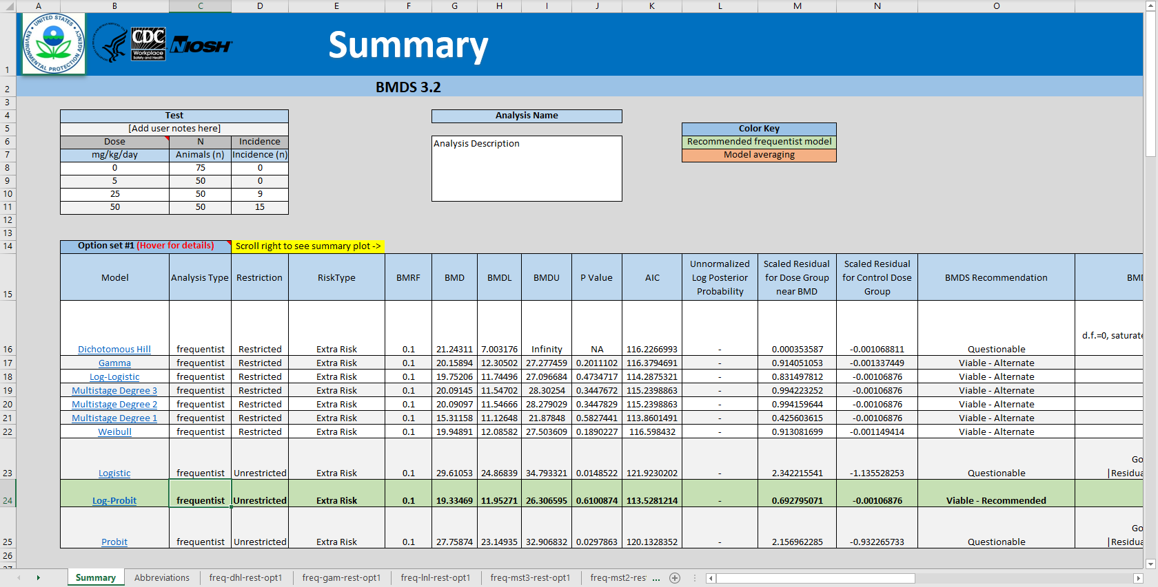

Slide 11
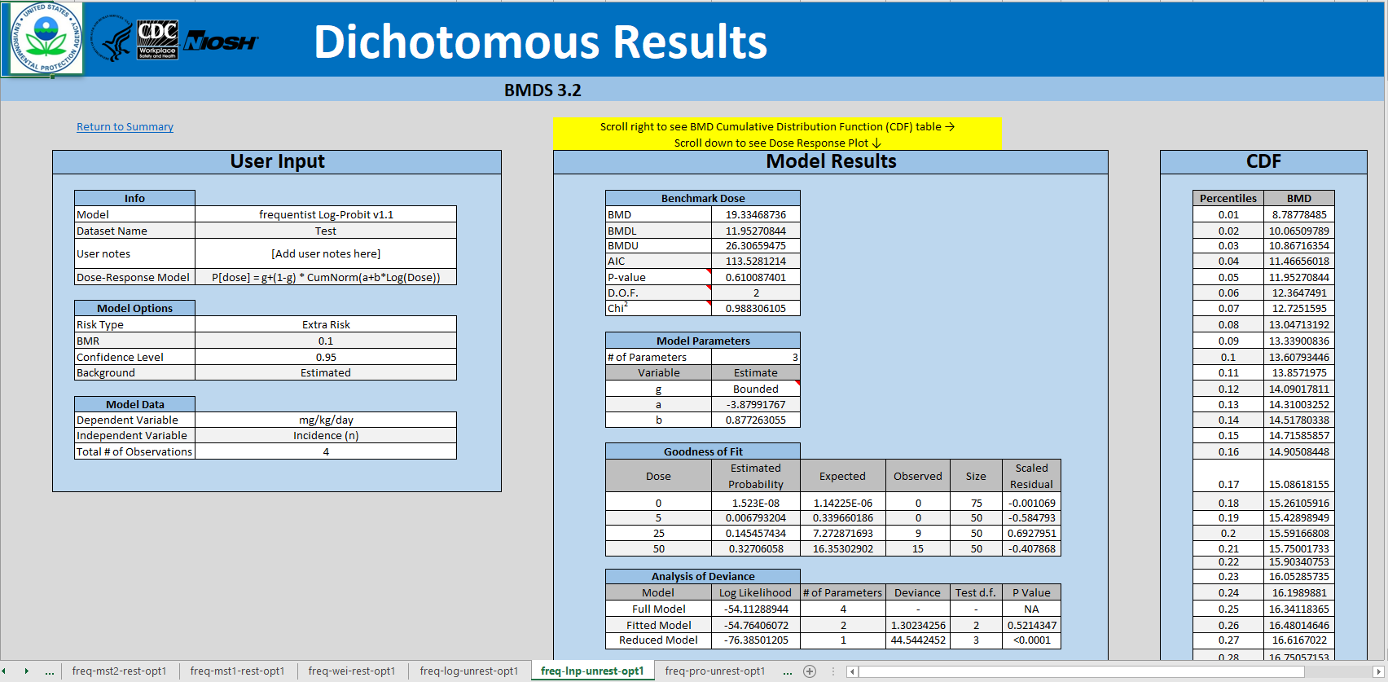

Slide 12
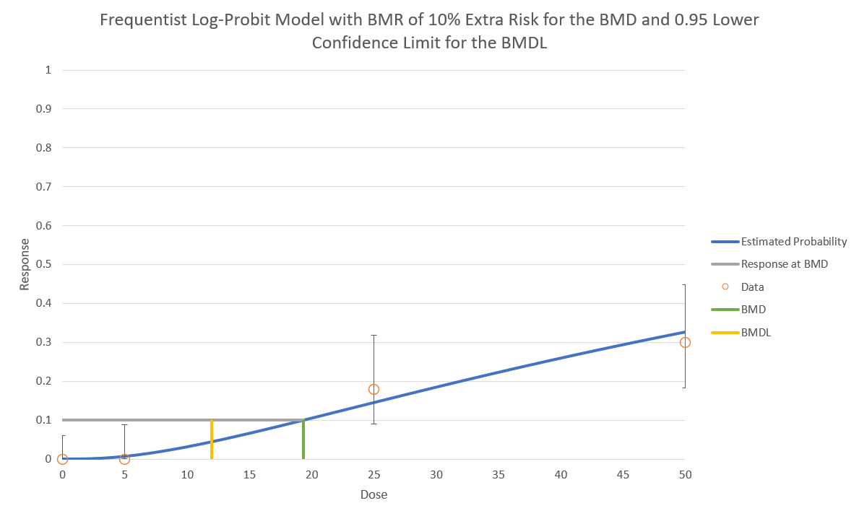

Slide 13
Another example BMD > highest dose tested

Slide 14
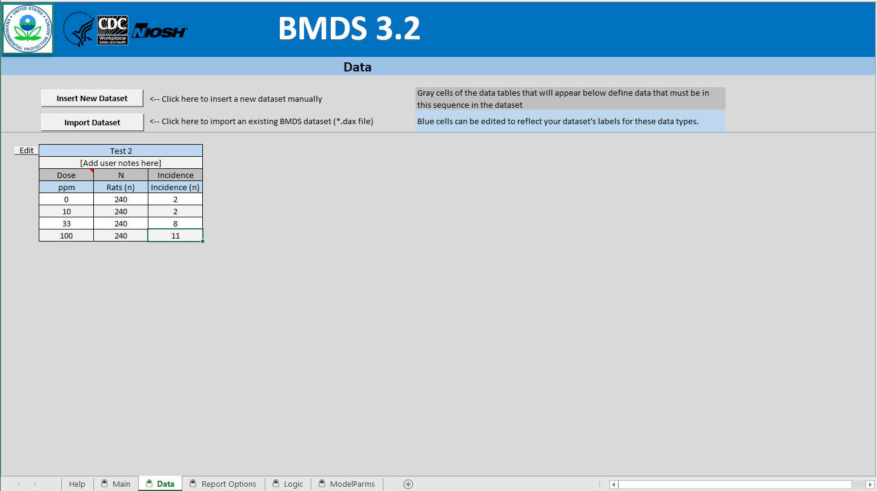
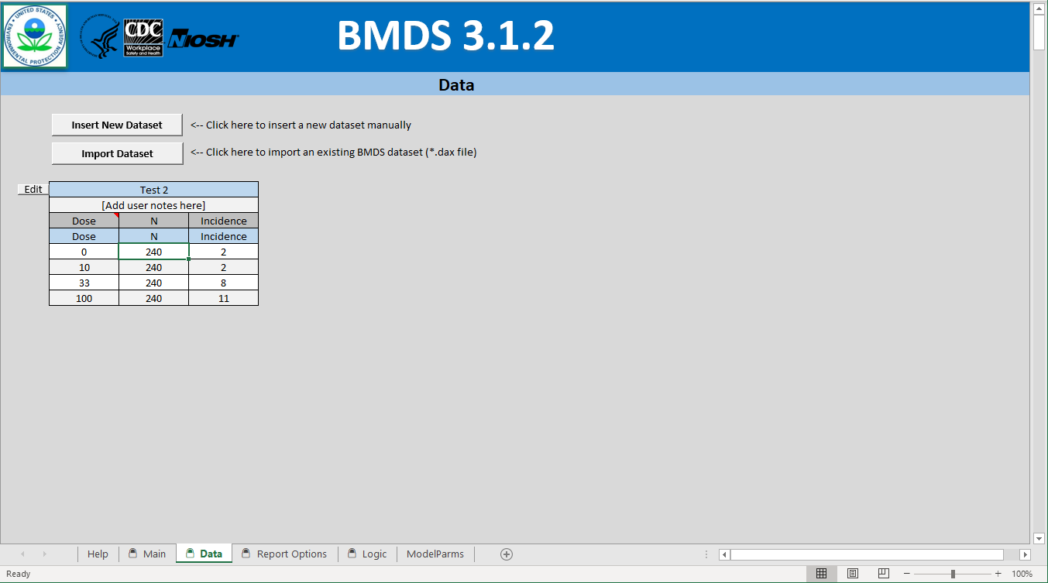

Slide 15
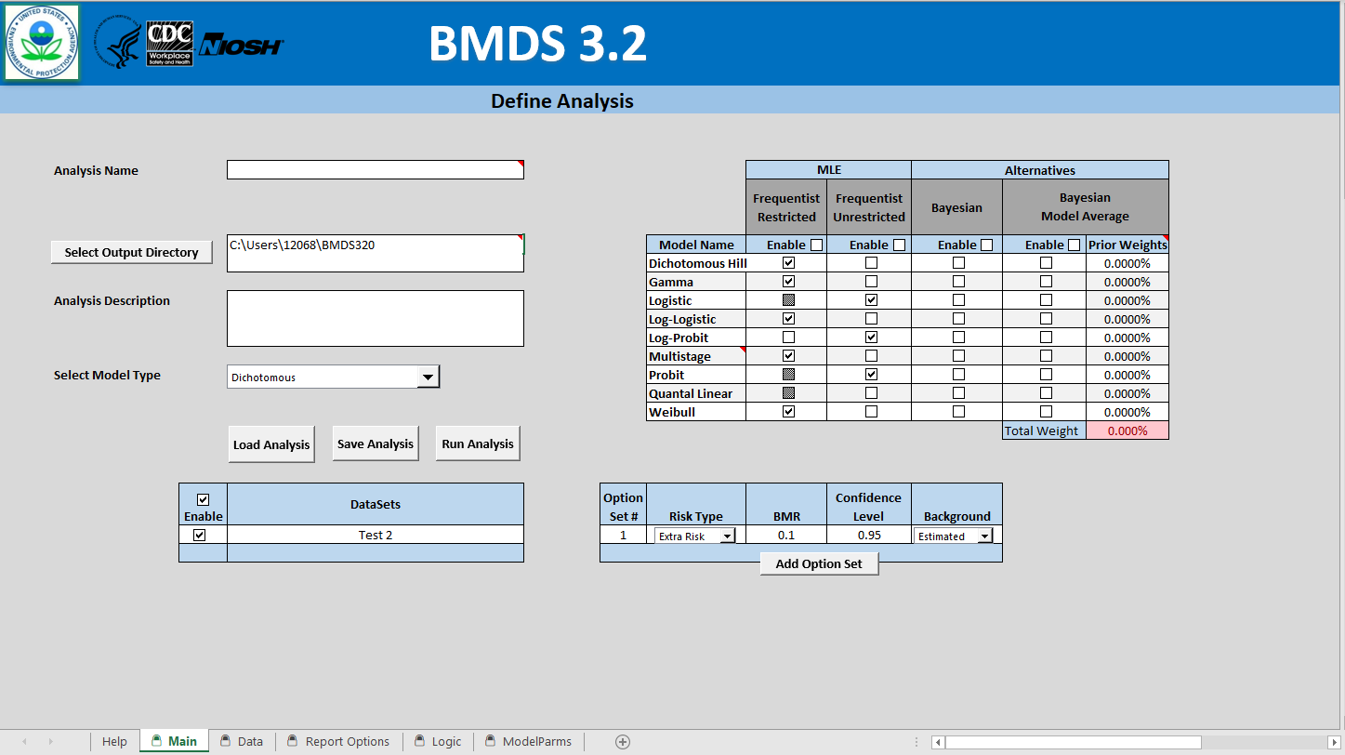

Slide 16
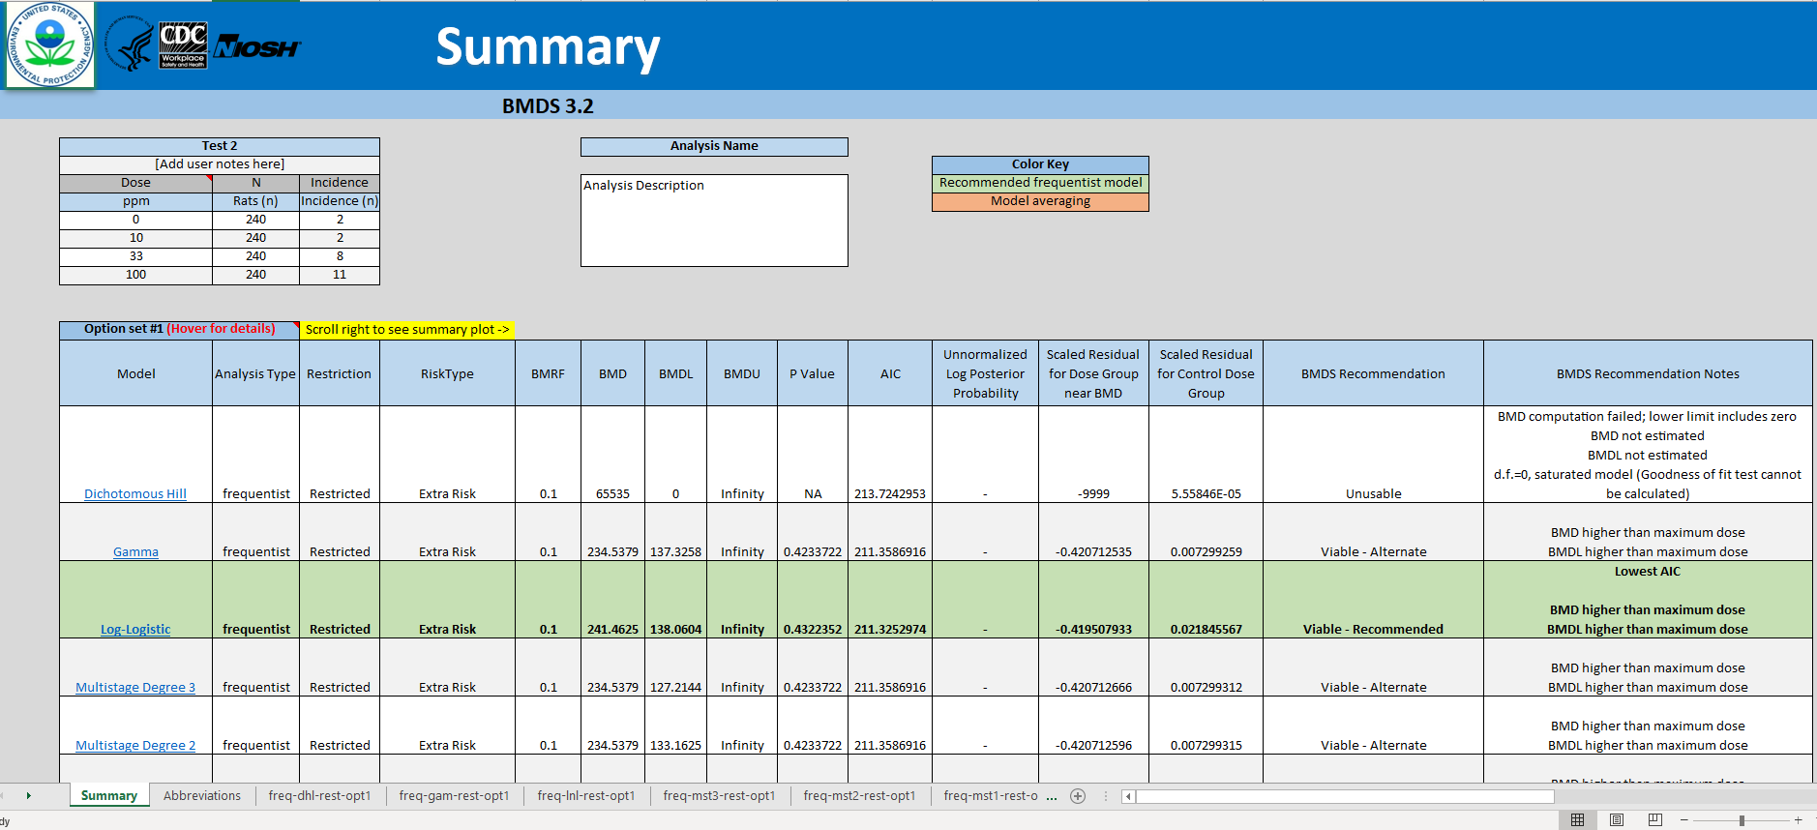

Slide 18
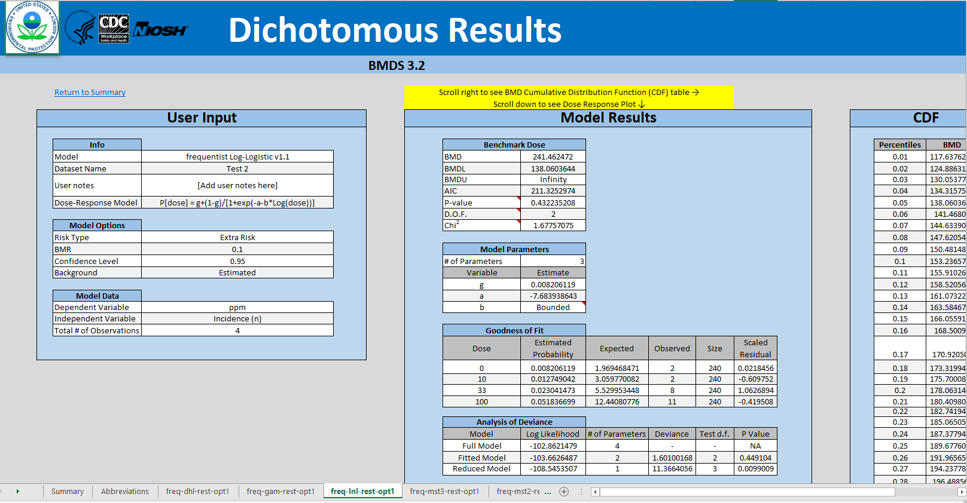

Slide 19
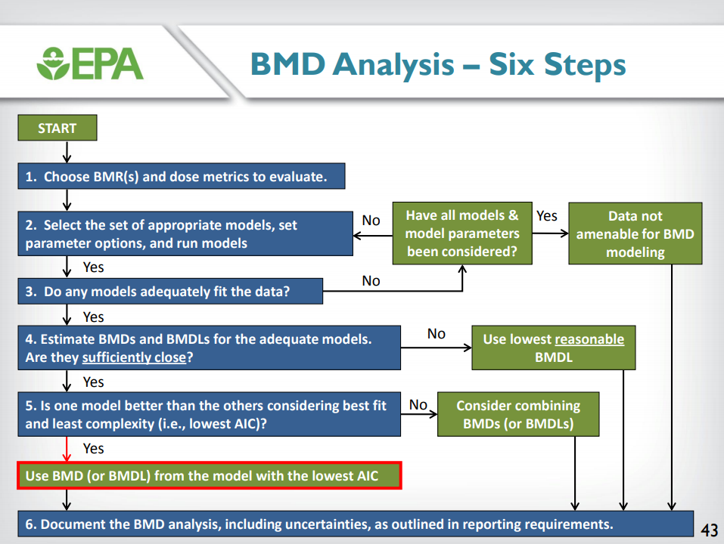
BMDS Decision tree for Dichotomous Models
Note: After evaluating models for global fit (good-of-fit p value > 0.1) and local fit (scaled residuals with absolute value <2.0) per Step 3, the Akaike Information Criteria (AIC) is typically the final deciding factor in choosing the model with the best fit.
Recent versions of BMDS have automated this process.
https://clu-in.org/conf/tio/BMDS1/slides/BMDS_Dichotomous_Models.pdf

Slide 20
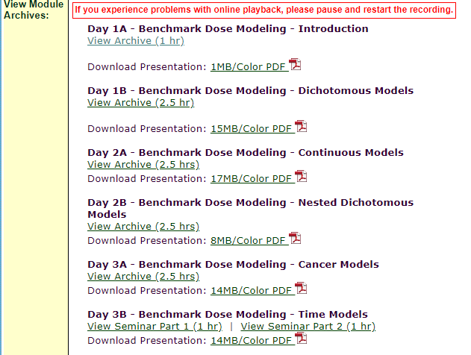
EPA Online Training archived for BMDS (2014)
Version 2.x archived training: https://clu-in.org/conf/tio/bmds/
In addition to the BMDS User Guide and other currently available documents, EPA has an archived BMDS training from 2014.
Note that BMDS Wizard training and some other features (pertaining to software before the release of BMDS versions 3.x) may not be as relevant. However, this training provides additional guidance on the theoretical approaches behind using certain models.

Slide 21
Differences in BMD approaches
Recommendations between US EPA and EFSA (European Food Safety Authority) differ, including:
Choice of BMR (benchmark response) for continuous data
Use of unrestricted models
Mathematical models used
BMD field is moving towards model averaging, as opposed to choosing lowest values (i.e. AIC).
Need to consider underlying biological considerations
More research needed on UF and appropriate BMR values

Slide 22
EPA BMDS
EFSA PROAST
Includes models for nested dichotomous data (for multi-generational studies)
Does not recommend modeling with BMDS in cases where response in all dose groups is high (too uncertain) – use NOAEL/LOAEL approach or obtain more data instead.
No default BMRs but suggests various options, e.g. 10% for quantal data, 5% for certain biological effects
Model selection described as a two-step process: finding acceptable models via goodness of fit / scaled residuals, the selection of the best choice among those models (i.e. recommended lowest AIC value)
For Continuous data with no consensus on BMR, EPA recommends a BMR corresponding to a change in the control mean response of one control SD.
Alternative approaches for continuous data: Concern about the potential for different degrees of response being associated with the same percent change for different endpoints
Differences in model restriction (discussed in finalized WHO paper)
No nested models
Recommends 10% BMR for extra risk as an appropriate default
For Continuous data with no consensus on BMR, EFSA (2017) recommends a default of a 5% change in the mean response
Alternative approaches for continuous data: Concern that defining the BMR in terms of the control variability results in the BMD varying with study-specific factors
Decision tree includes consultation with BMD specialist and consideration of convergence and broader criteria for AIC values for statistically acceptable models
Model averaging is preferred
Commonalities:
Recommended use of Extra risk
Both avoid dichotomizing data from continuous data (EPA more explicitly notes loss of information)
Interest in harmonization and consideration of biological considerations

Slide 23
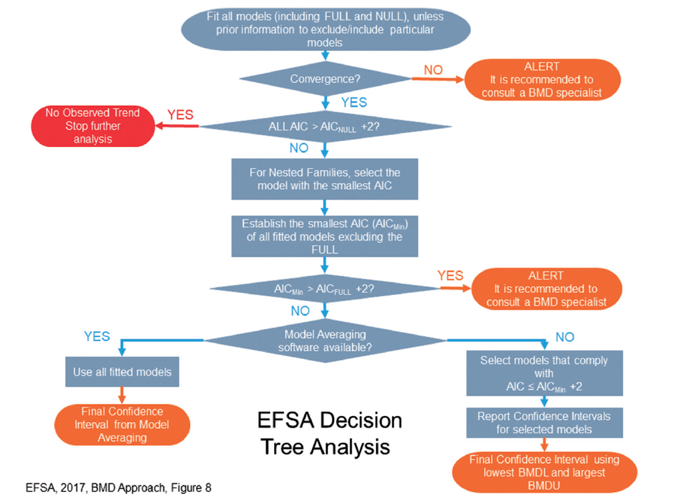

Slide 24
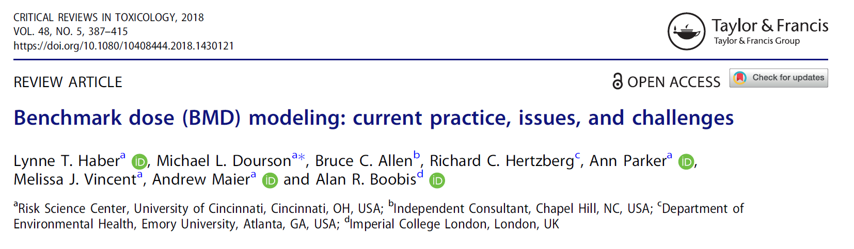
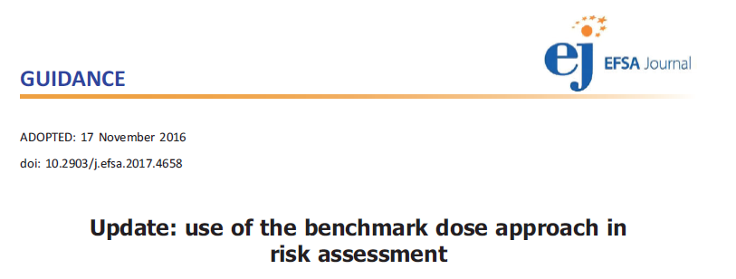
Additional Readings

Slide 25
The following features will be rolled out in future BMDS releases:
Analysis of two-dose datasets
Report parameter standard error (SE) values
Implement NCTR nested dichotomous model
Recompile models for improved speed (particularly for “Added Risk”)
Add Asymptotic Correlation Matrix of Parameter Estimates table to dichotomous output
Implement improvements to Results Workbook and Word Report feature
Implement confidence intervals for plotted group responses
Implement Cochran-Armitage trend test for dichotomous datasets
Implement data transformations on a column of data (for example, multiplying by a constant, returning the Log() base 10 of all values in a column, or converting standard errors to standard deviations, among other types of transformations)
Auto-update feature
Bayesian models for continuous response data
Bayesian model averaging for continuous response data
Sensitivity analysis for Bayesian priors (posterior distributions for alternative priors)
P-value (or equivalent) for Bayesian models
Covariate capability for all models
Risk-at-a-dose capability for all models
Model Averaging plots

